Slide 1
Data Casting over
ATSC Broadcast
UniSoft Corporation
audrey@unisoft.com, grh@unisoft.com
November 14, 2022
www.unisoft.com

Slide 2
Quick Introduction
UniSoft is a software company which offers ATSC 1.0 and ATSC 3.0 data casting delivery for broadcasters.
Is a reseller and systems integrator for ATSC 3.0 delivery components.
Founded in 1981 originally as a UNIX porting house.
Guide data delivery with TSBroadcaster for Charter, Cox, Altice and Videotron.
Active in the ATSC space since 1997. DASE conformance test suite.
Broadcast Application, using SCTE 35/104 and Xlinks for content replacement.
Deployed ATSC 1.0/3.0 Educational Datacasting solution in Pennsylvania PBS stations and VPM.

Slide 3
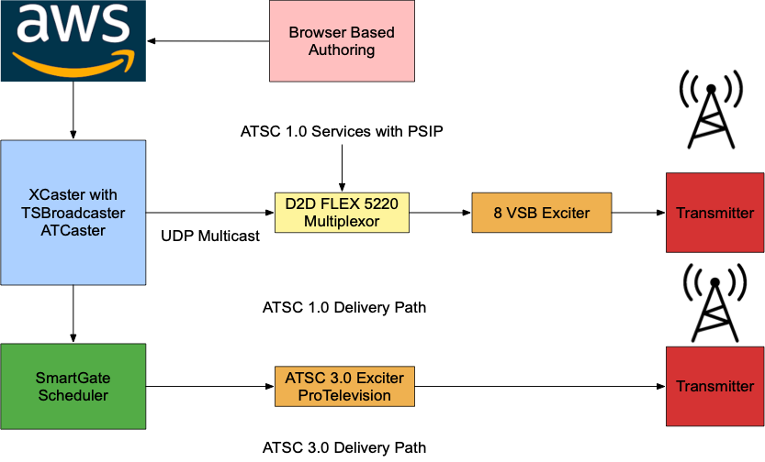
Remote Learning Delivery Paths

Slide 4
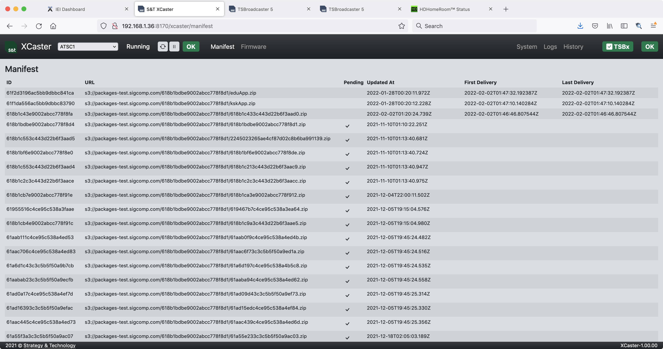
XCaster User Interface

Slide 5
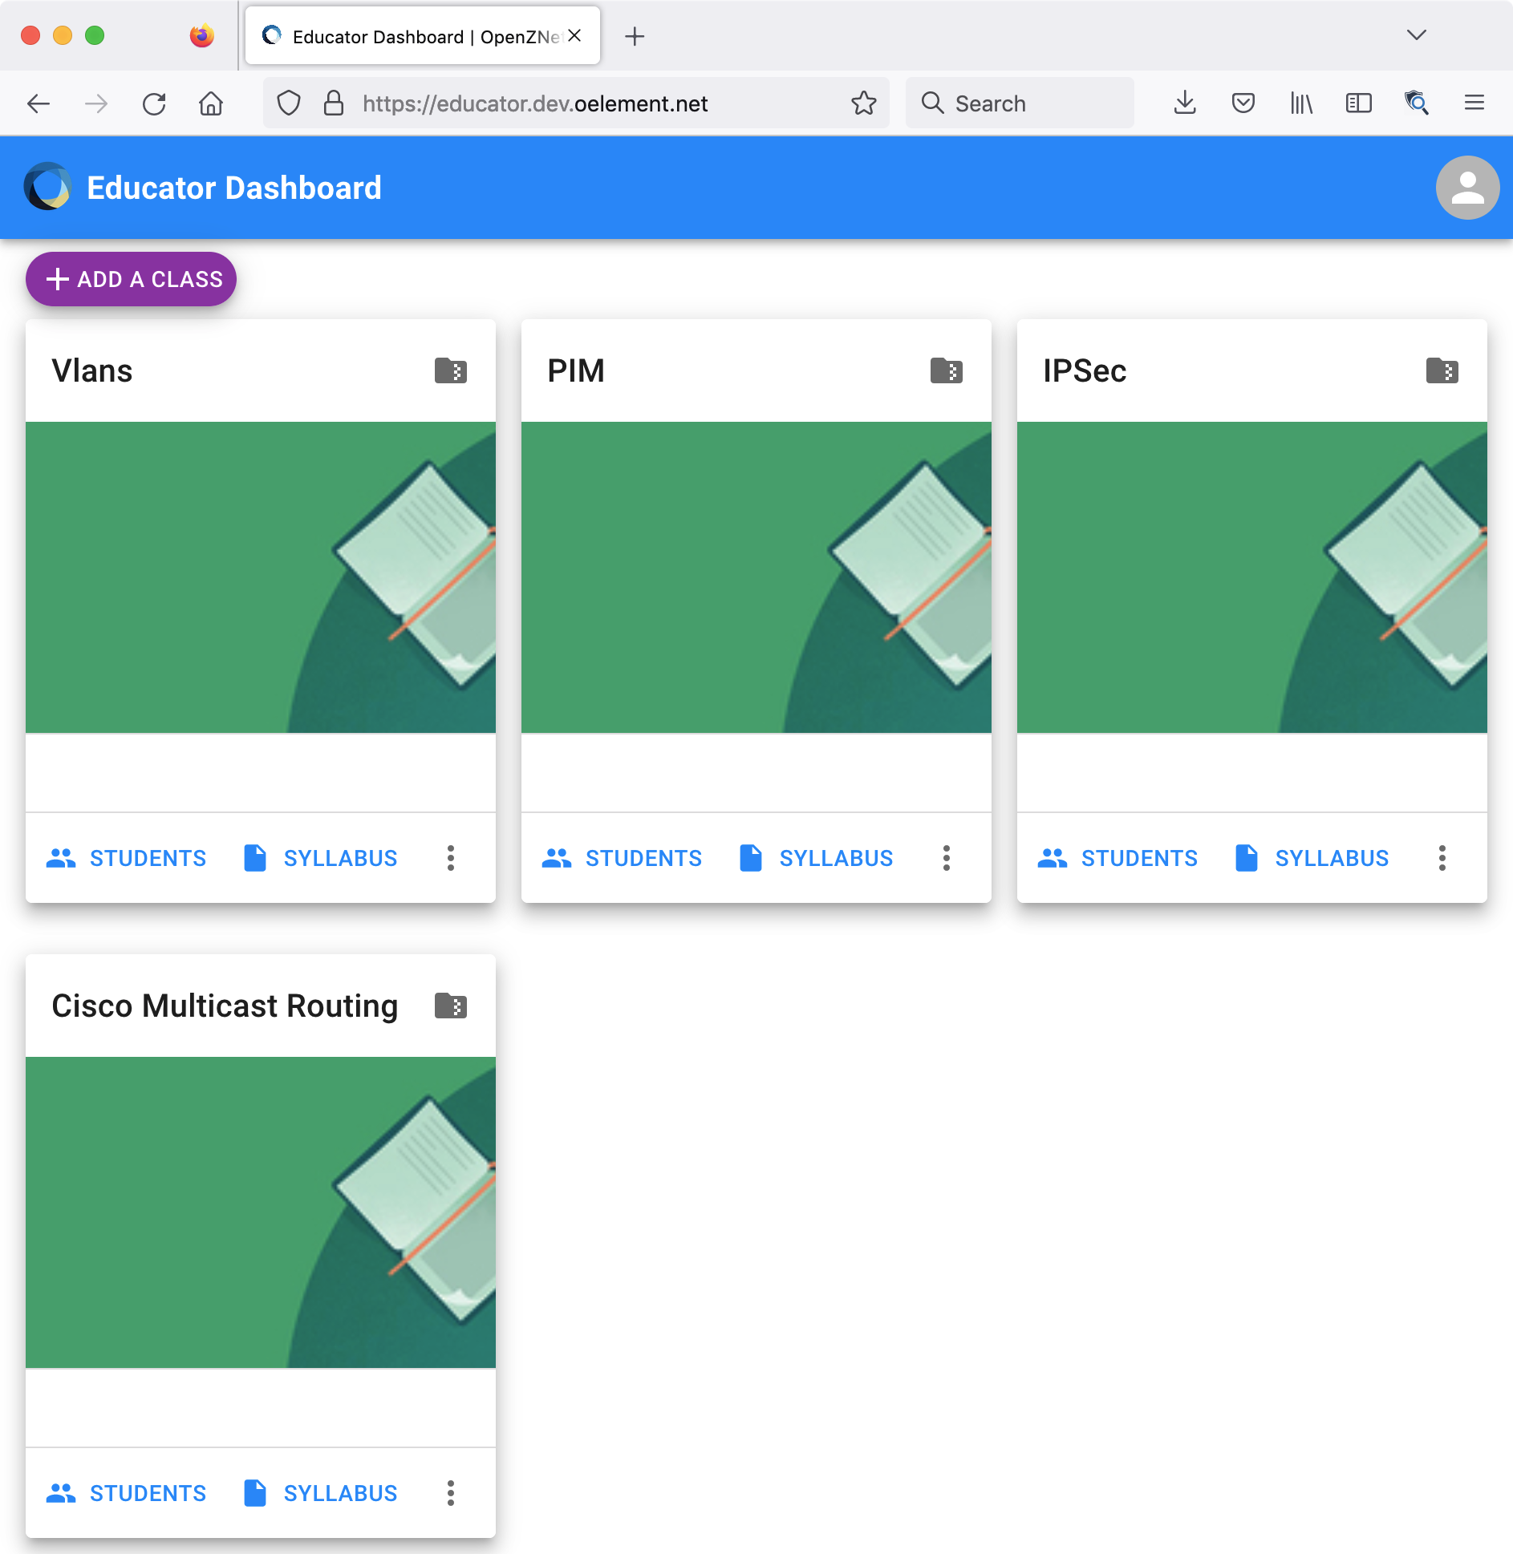
Authoring Content

Slide 6
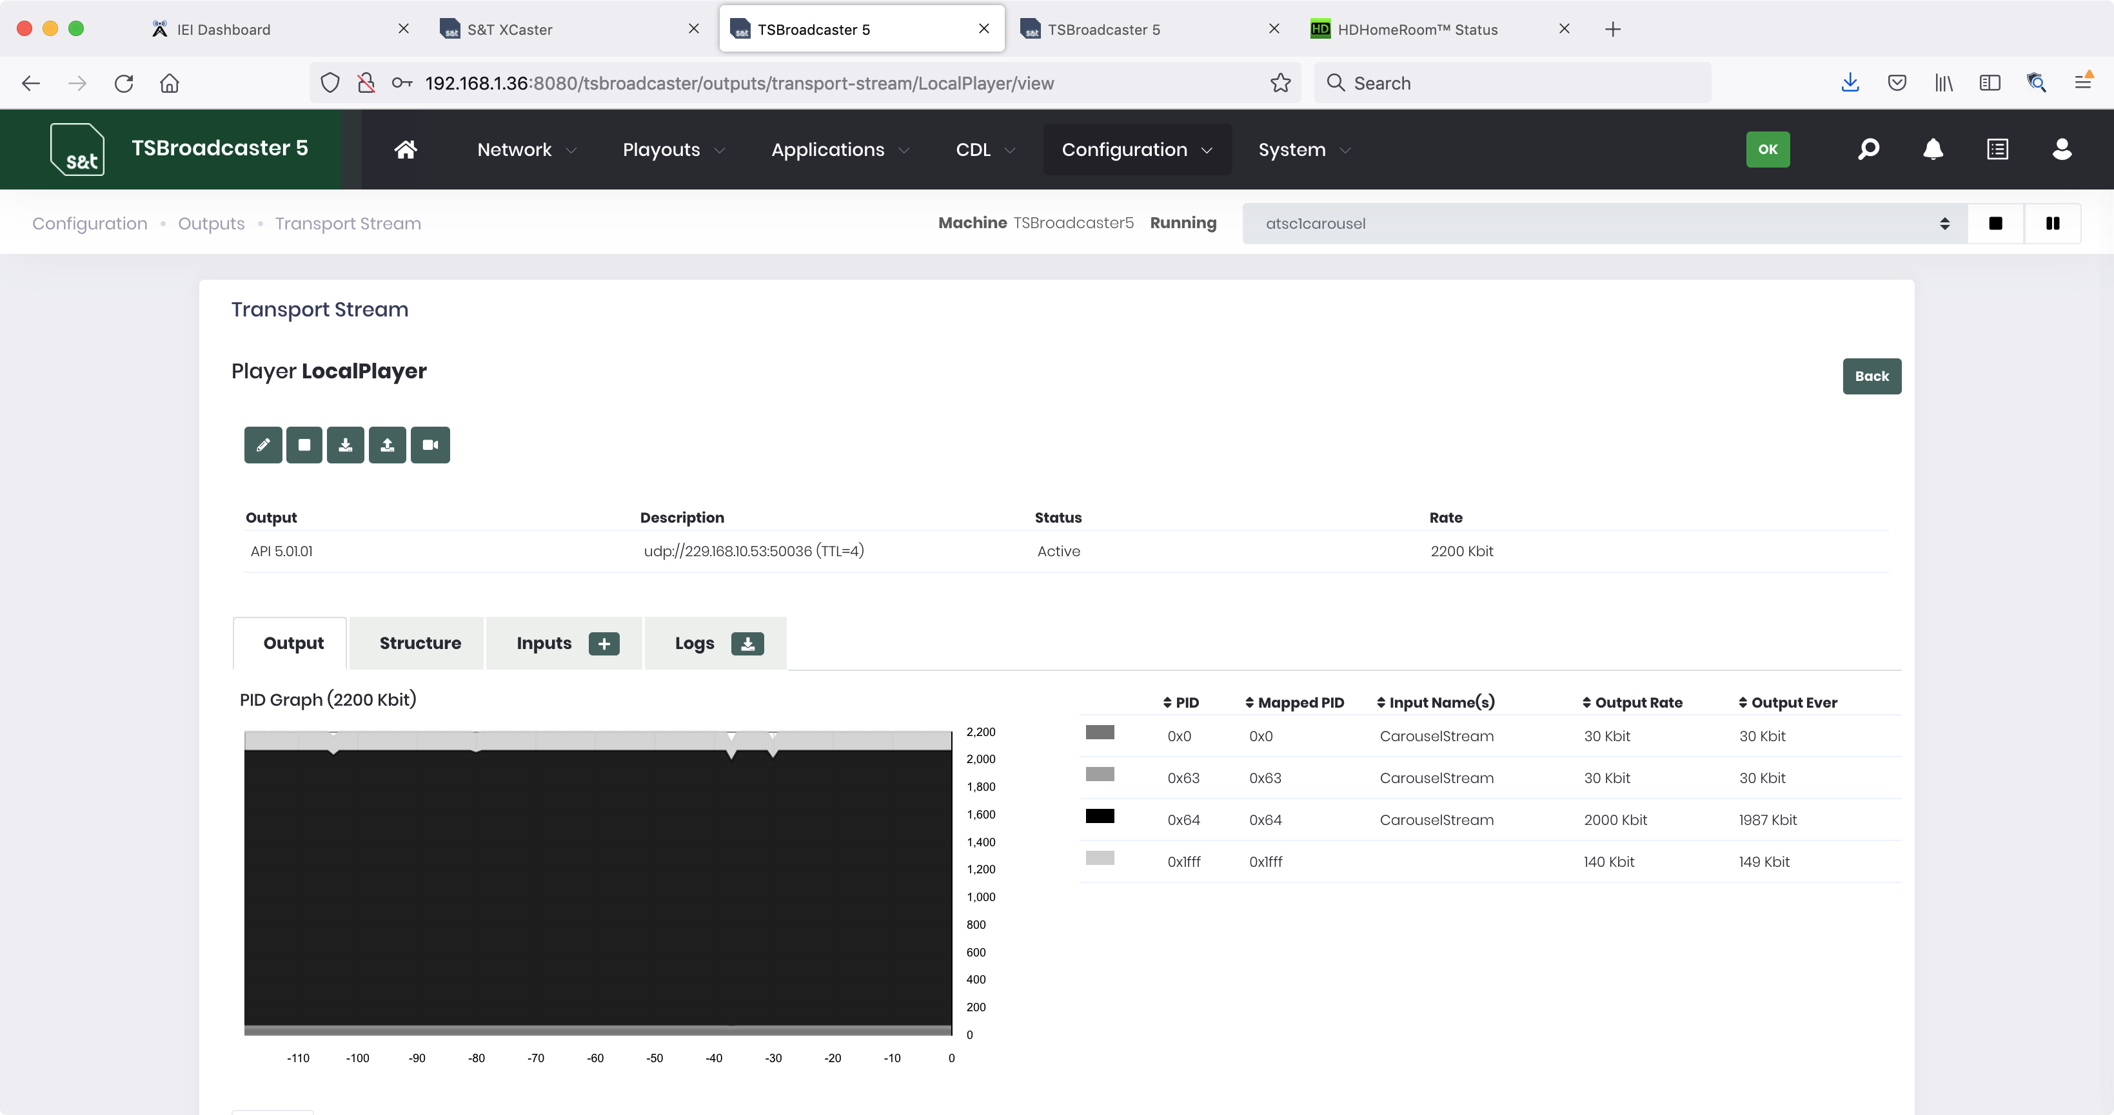
TSBroadcaster User Interface

Slide 7
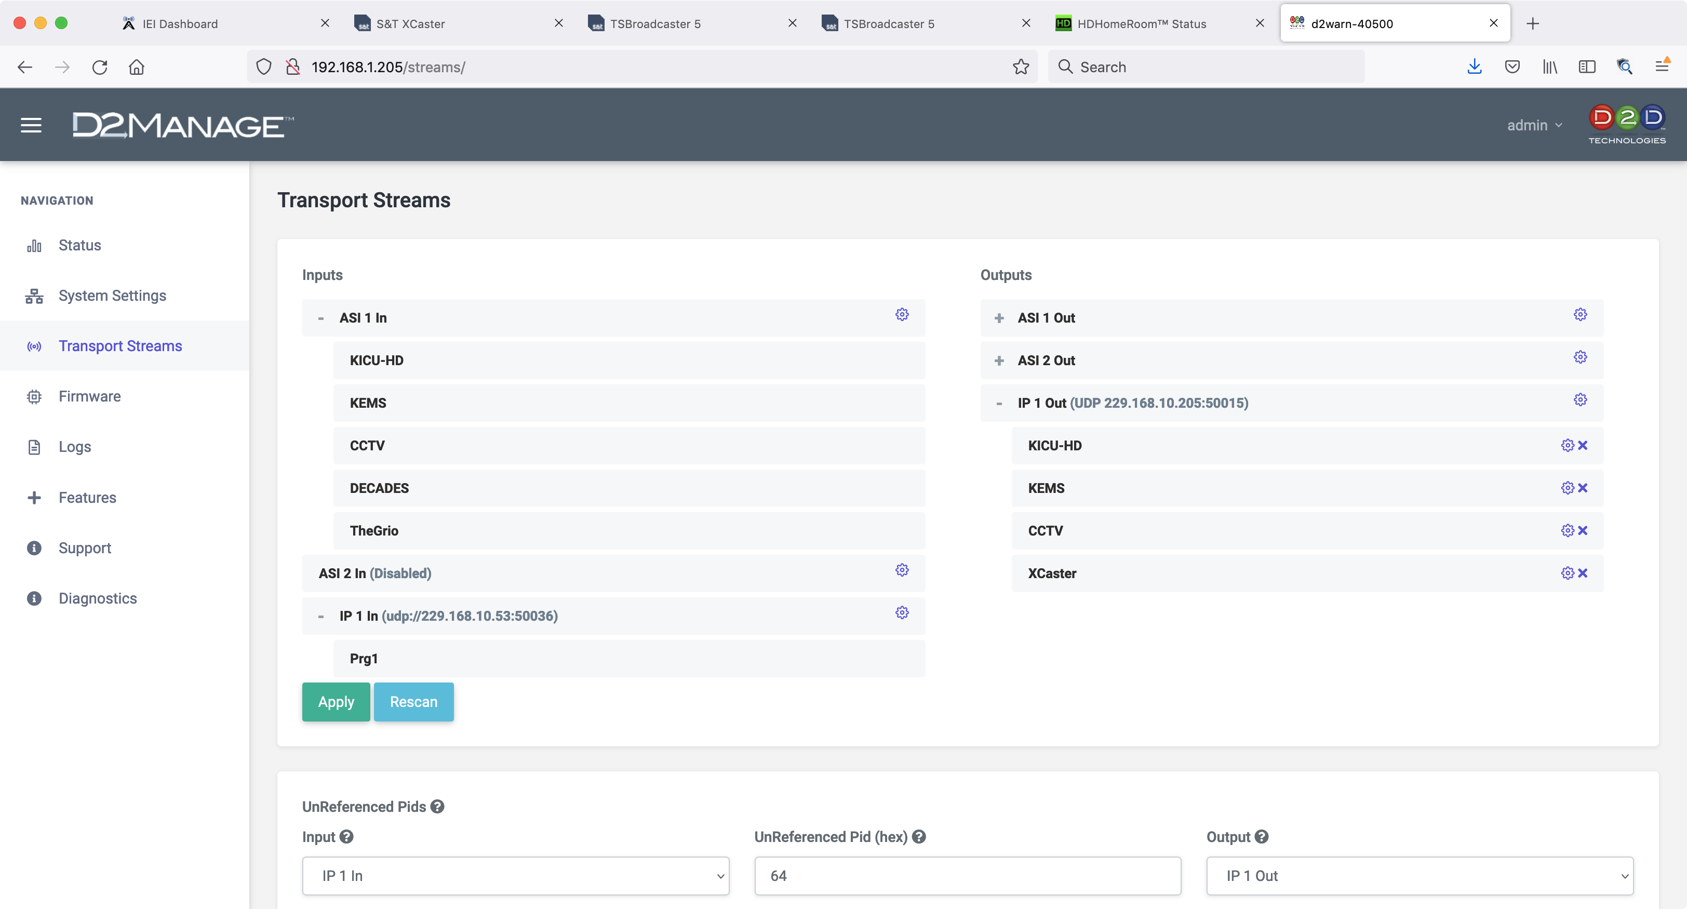
Mux Data Service using D2D Flex 5200

Slide 8
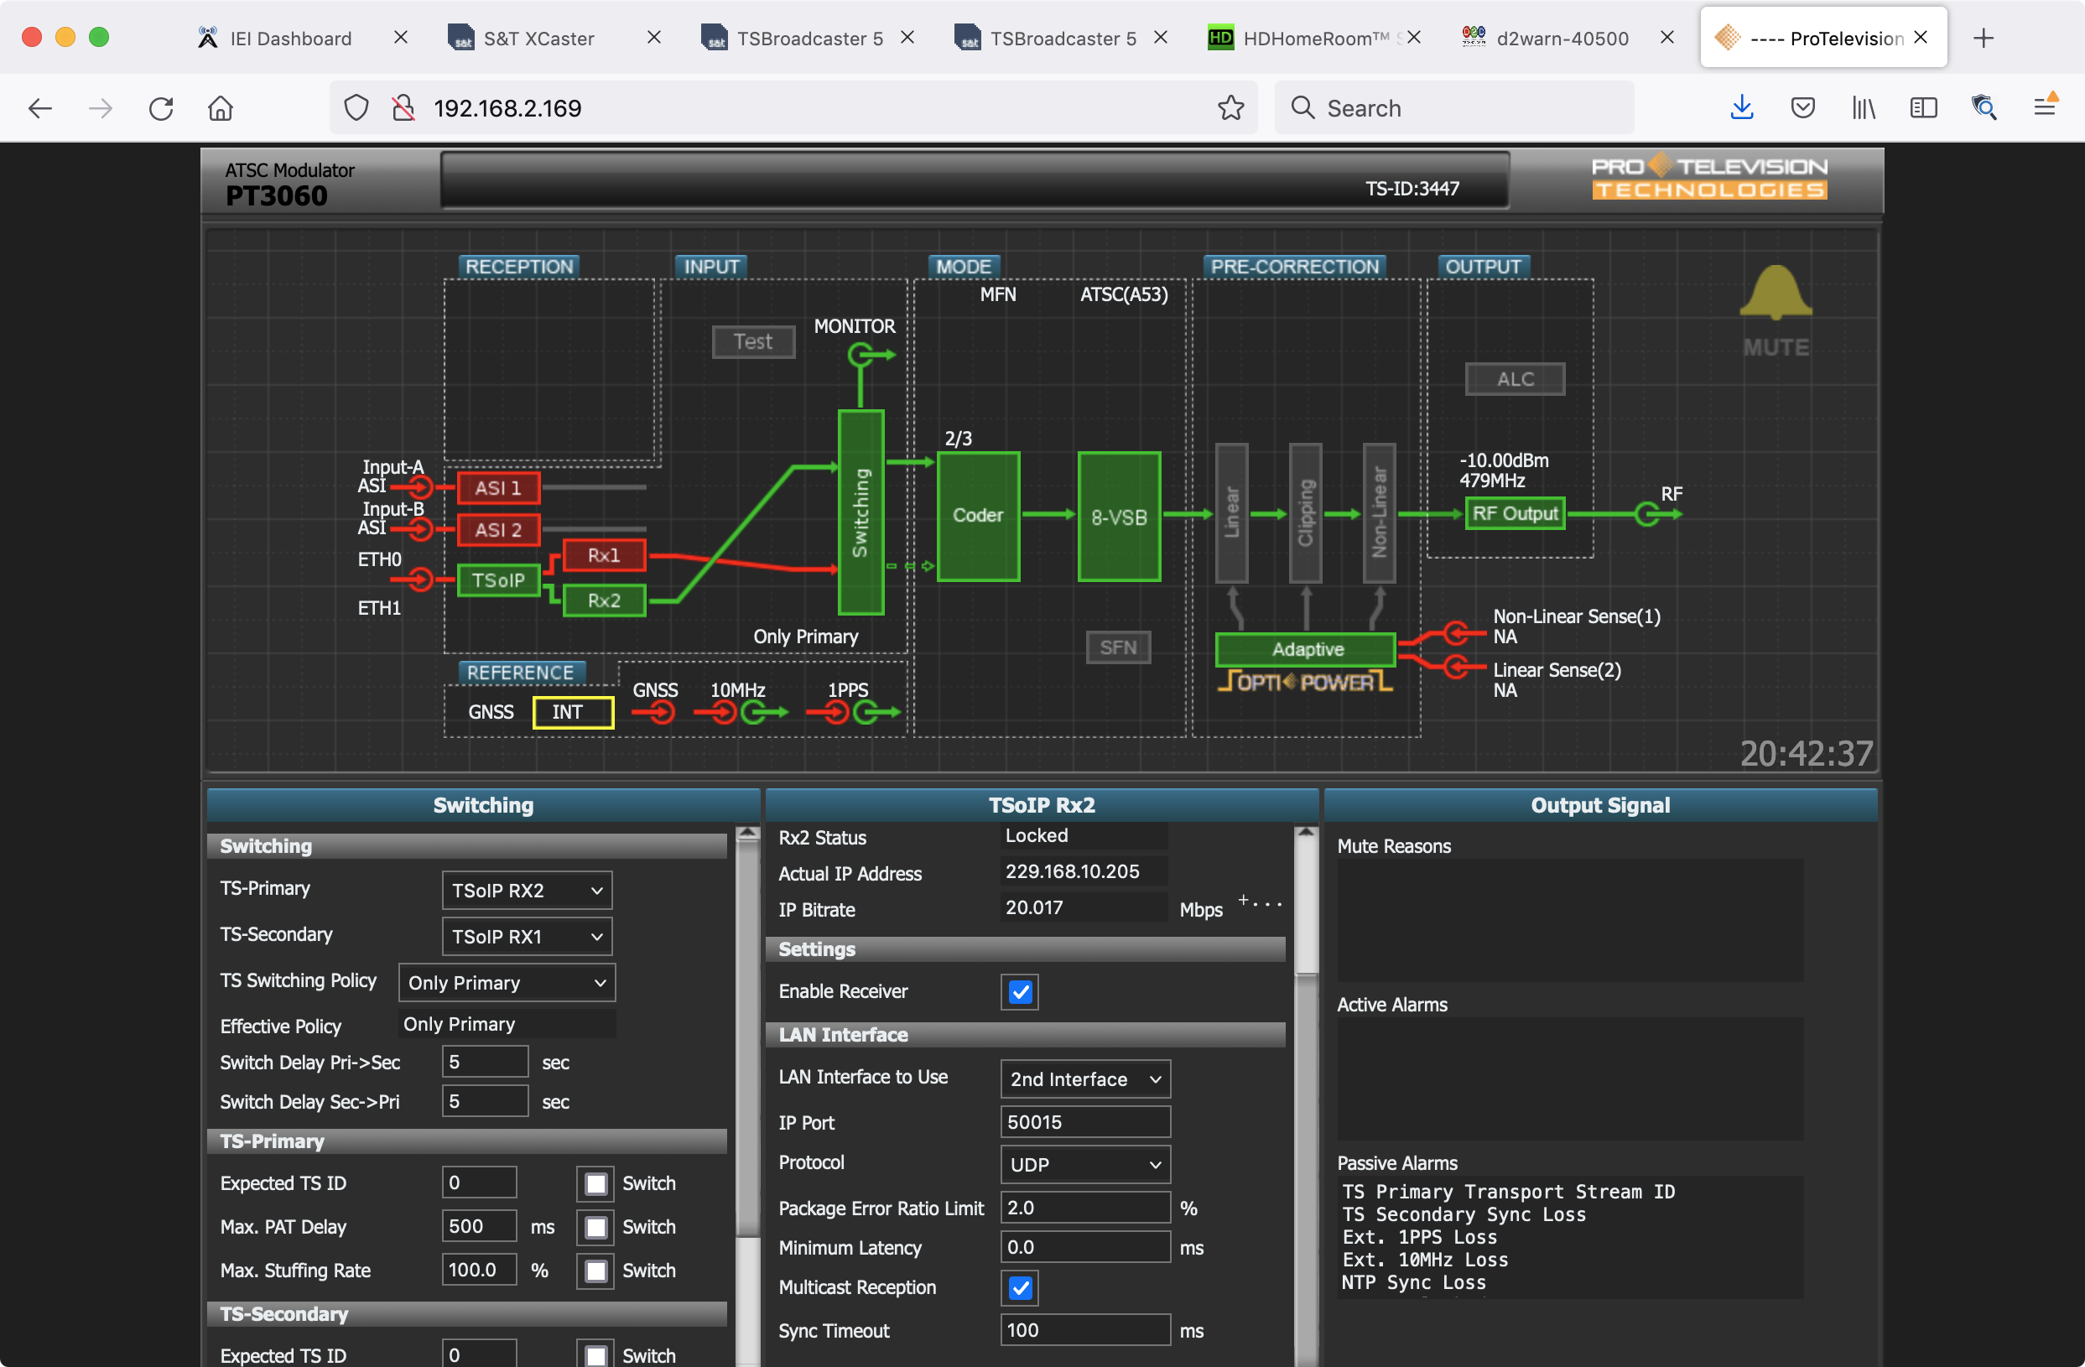
ProTelevision 8VSB Exciter

Slide 9
D2DFlex

Slide 10
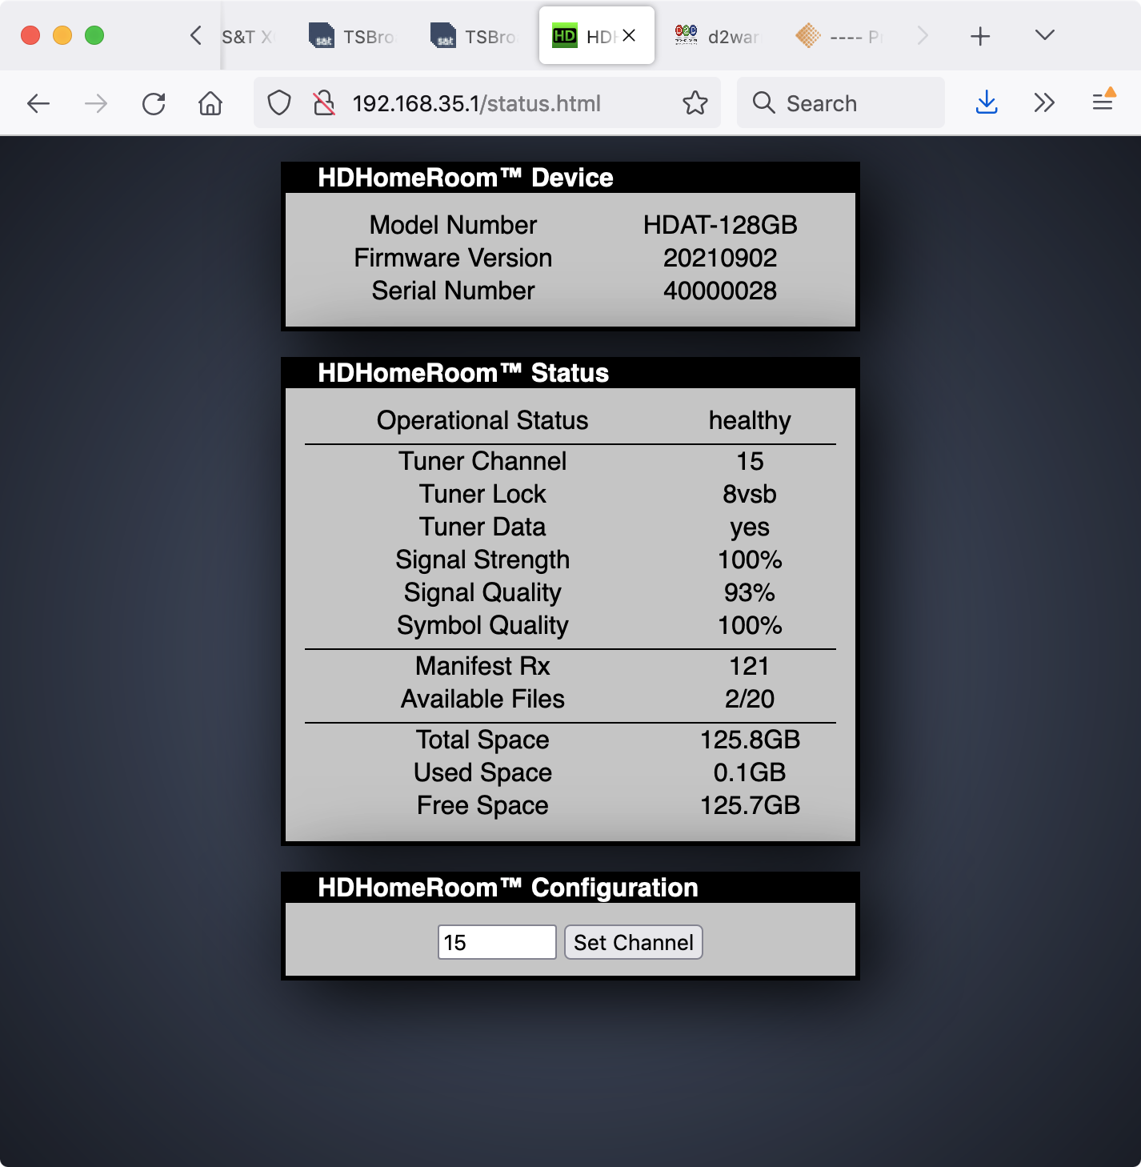
HDHomeRoom Receiver

Slide 11
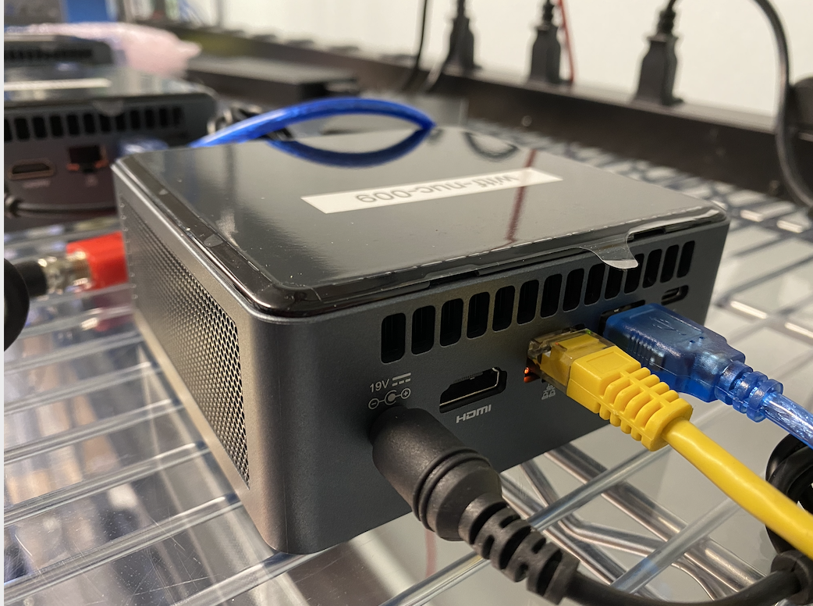
Classroom Gateway
Suitable for classrooms,
medical facilities and
prisions.
Ubuntu installed on an Intel NUC PC.
Airwavz RedZone Receiver.
S&T ATSC 1 and 3 receiver software.
UniSoft sendmc multicast subsystem.

Slide 12
HDHomeRoom Receiver

Slide 13
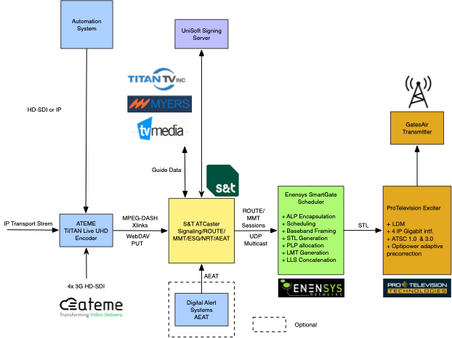
ATSC 3.0 Delivery System

Slide 14
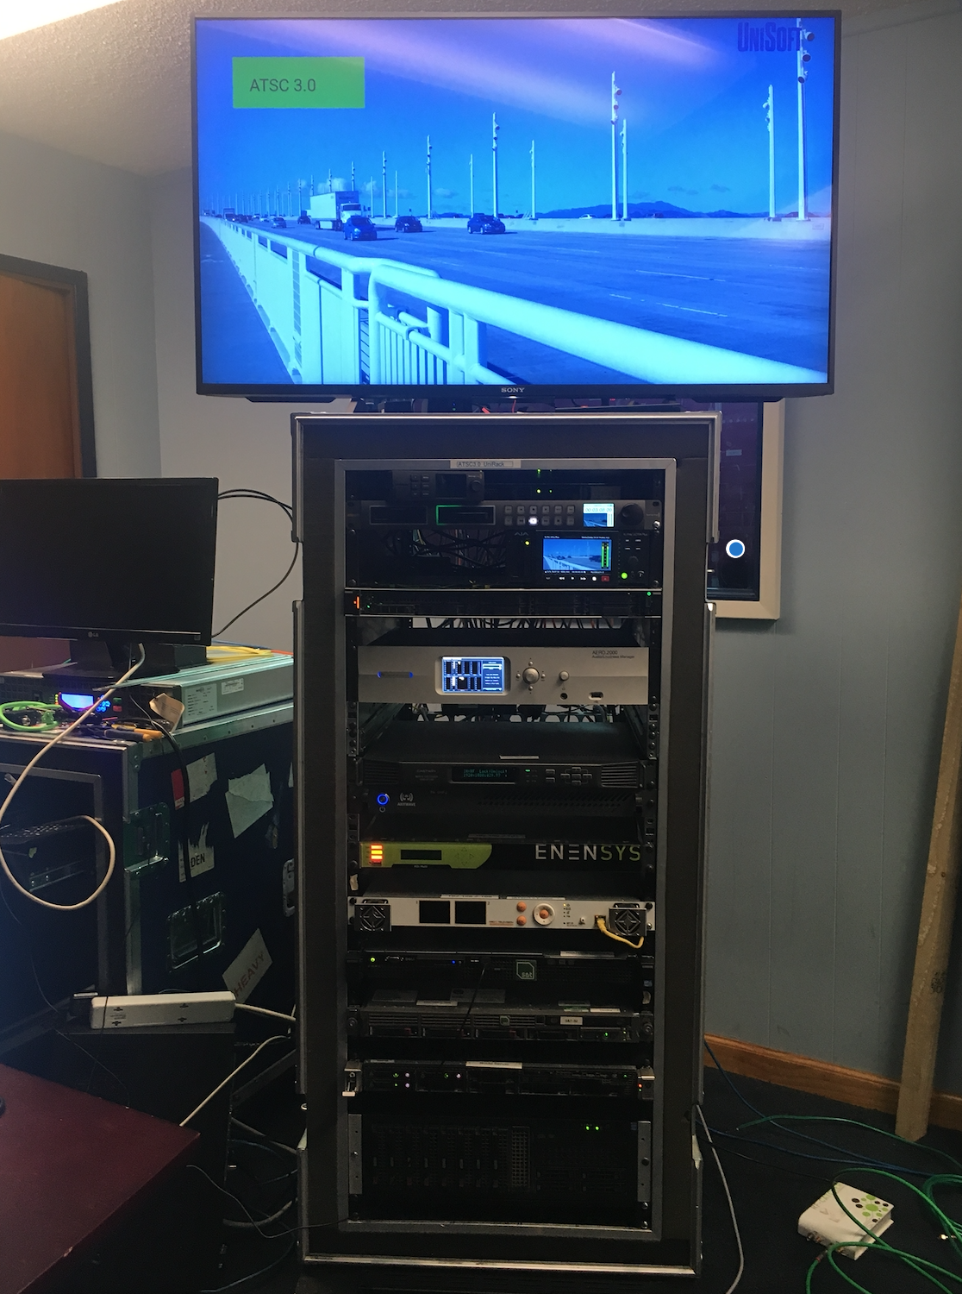
TV Station
in a Box

